Slide 1
BURGUNDYSIP WINE STORE ANALYSIS & MODELS
Course: Data Handling & Decision Making

Slide 2
Introduction to BurgundySip Wine Store:
For our project, the BurgundySip wine analysis was done through the R software, with use of extra installed packages such as dpylr, ggcorrplot and PerformanceAnalytics
Summary :
In this project we study to investigate data relationships, trends, and patterns in price as well as other variables to help BurgundySip streamline the pricing strategy. This is done by Cleaning the Data, Finding relationships between the variables , Prediction and Clustering.

Slide 3
ANALYTICAL OBJECTIVES
Descriptive Statistical
Predictive
Analyze how the age of the wine and price are related.
Understand how the rating of the wine is related to the residual sugar content.
Categorizing the inventory by price
Find out how the price is related to the rating of the wine
Find out which wine has the highest rated and lowest rated according to the wine region, wine variety and winery.
Use polynomial regression to predict price and residual sugar according to Rating.
Use Logarithmic Regression to predict Alcohol Percentage according to Density
Cluster Based
Perform a K -means clustering Analysis - Univariate of the burgundy data set to plot/find the profit ,popularity, number of buyers & sweetness.
Perform a K -means clustering Analysis - Univariate of the burgundy data set to find the predictive profit.

Slide 4
Assumptions
To remove the duplicates according to the SerialNo we choose Bottom to top approach because when analysing the duplicated observations for each SerialNo we have found that ResidualSugar level is decreasing with every next sample, according to the fact the ResidualSugar level decreases during fermentation. So we assume the last observation is when fermentation stops and that is the final Residual Sugar level for wine.
N.V mentions non-vintage wines.
N.V wines are made in the present year (converted into 2022,) by mixing different years of wines together
There were outliers when plotting the boxplot. But these outliers are acceptable because there can be a wide range of Alcohol Percentage available in the market
Serial Numbers are unique values
Region and Winery is related

Slide 5
Data Analysis Process – Process Map
Process Map
Objectives
Importing Data
Tidy- Data Sanity Checks
Transform
Model
Visualization
Evaluation
Descriptive Statistical
Download DataSet - BurgundySIP
Form Data Structure, Convert Character type to required
Rename Variables & Levels to required
Aggregation & Summary through Correlation Matrix Plots& Box
Descriptive Statistics: Scatterplot, Histogram
Objectives Met
Predictive Analysis
Use code read.csv to load file
Handle Duplicates, Outliers & Missing Values
Transform variables, factors
Descriptive Statistics: Scatterplot, Histogram
Predictive Analysis : Scatterplot, Regression line
Cluster – Based Analysis
Manage Meta Data
Transform variables, factors
Predictive Analysis : polynomial & Logarithmic Regression
Cluster Based Analysis: K- means Univariate
Cluster Based Analysis: K- means Univariate

Slide 6
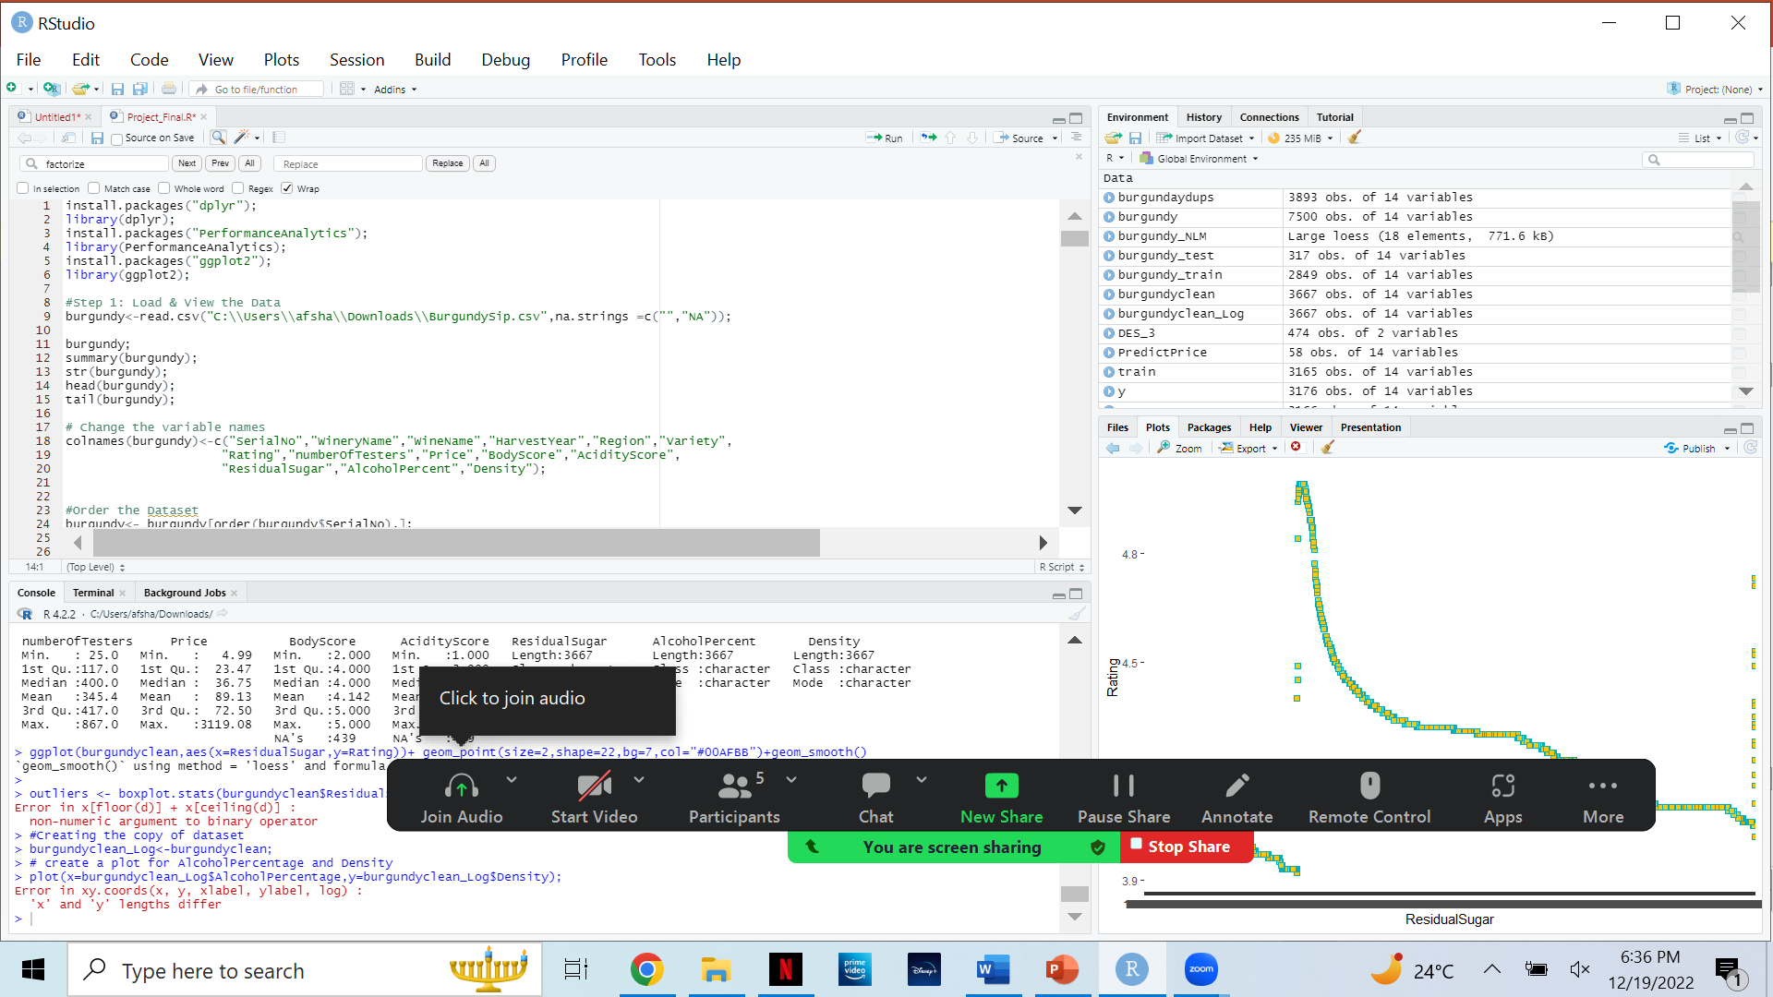
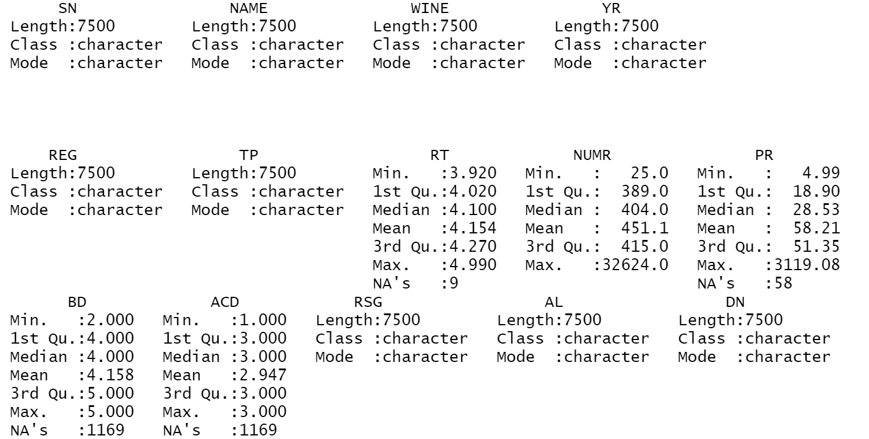
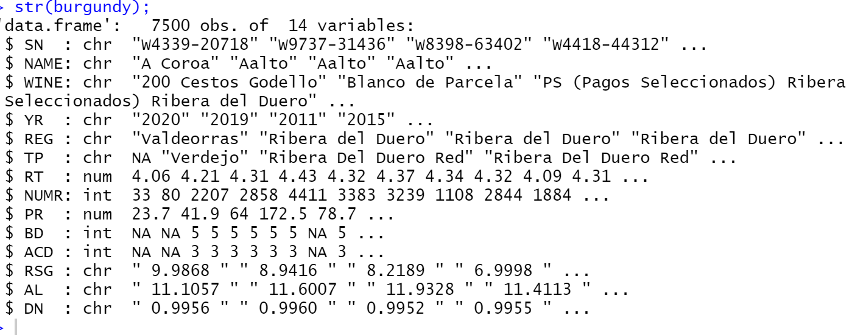
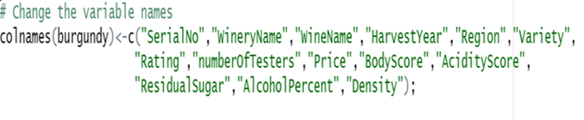
Data Sanity Checks
Importing Data
Variable Analysis
Importing Data
For importing Data, we have used the function read.csv() with option na.strings.
Variable Analysis
Variable Summary – Using the function summary()
Initial Visualization – Using function tail() and head()
Structural Integrity of Data Set – str()
Change variable names: We have changed the variable names for each variable because the original names were not describing variables in better way.

Slide 7
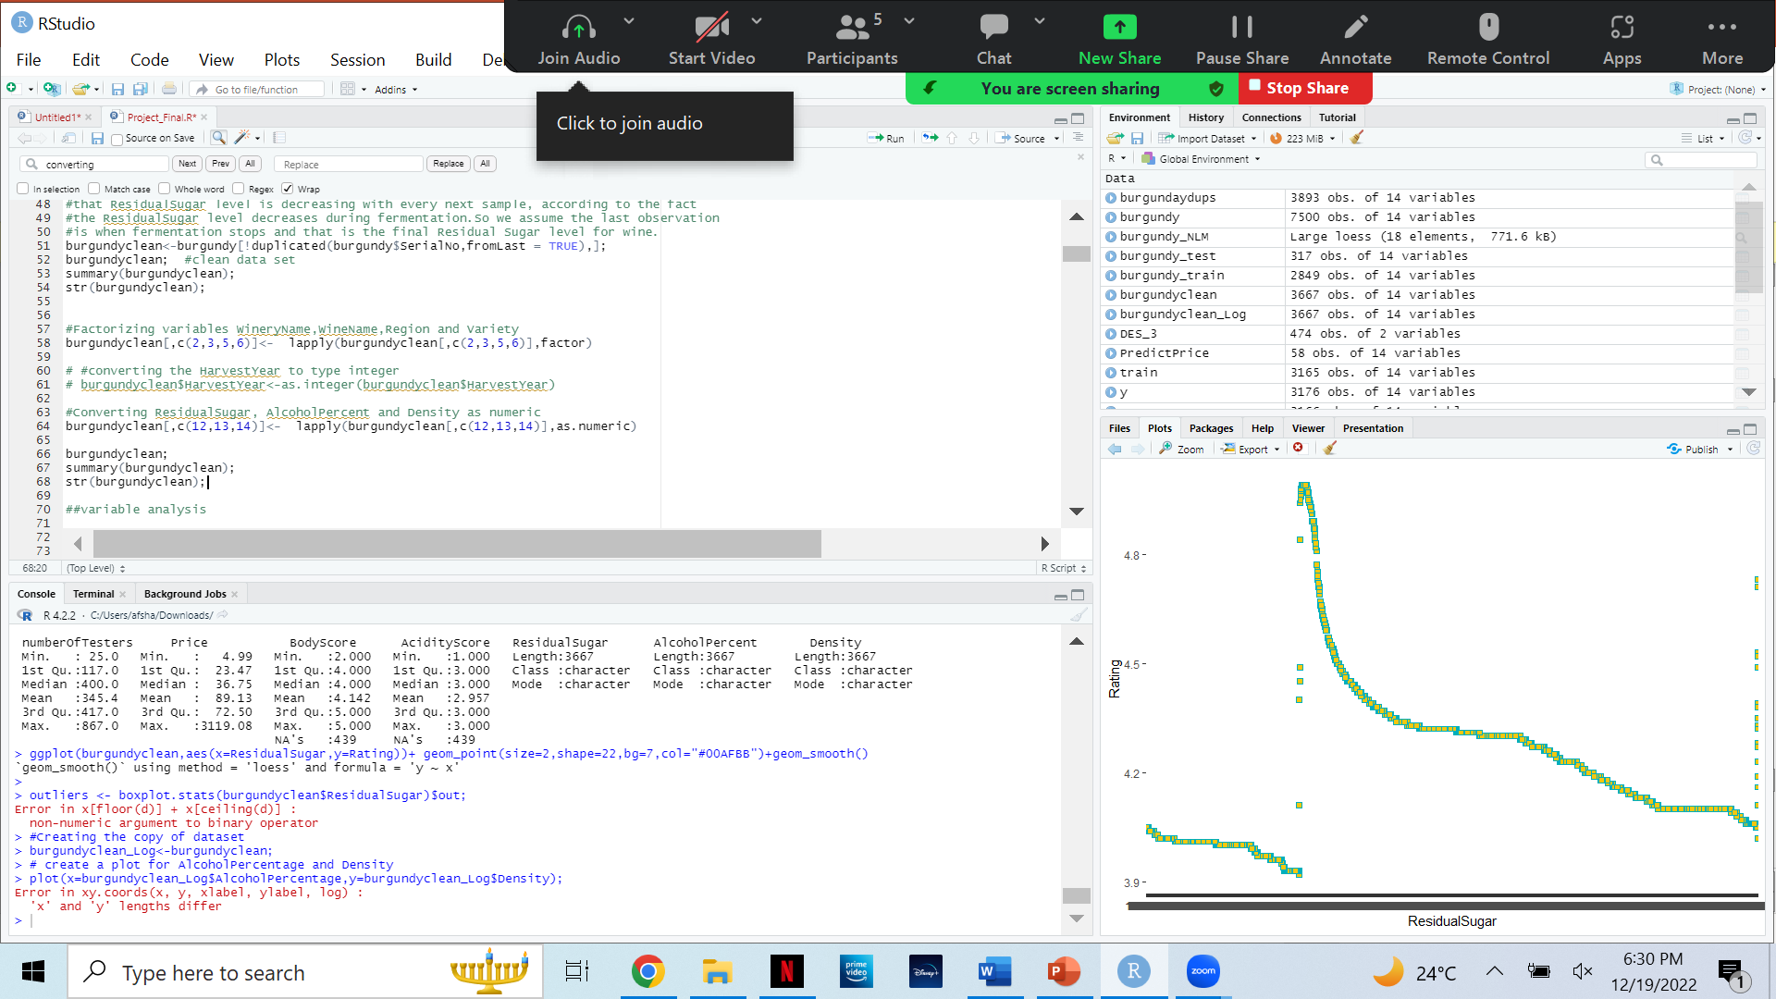

Data Sanity Checks
Variable Analysis (contd)
Casting/Conversion – The data given was Character data type. This was done by Converting ResidualSugar, AlcoholPercent and Density as numeric.
Treating Categorical Variables - This was done by factorizing WineryName, WineName, Region and Variety.
We keep the Harvest year as character for now because if we change its type as integer,the N.V.(non vintage)value get converted as NA. As we assumed N.V wines are made in the year 2022, by mixing together the wines made in different years . After Treating it we have changed the HarvestYear’s type as integer.
Converting type
Factorizing
Notes:
Variable Analysis (contd)
Casting/Conversion – setting data as character to numeric / integer
Treating Categorical Variables - factorized

Slide 8
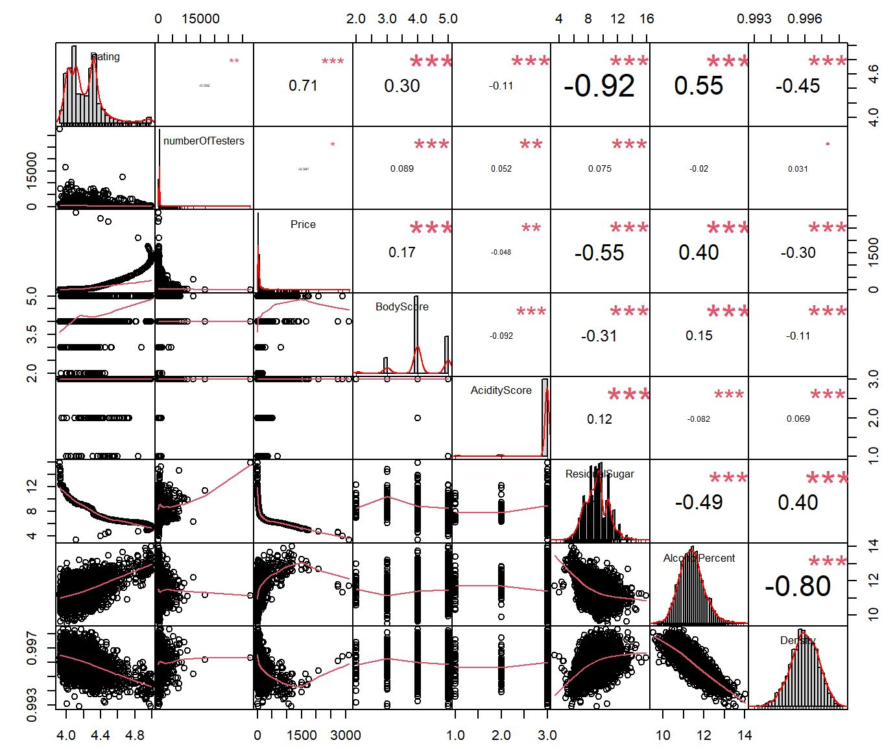
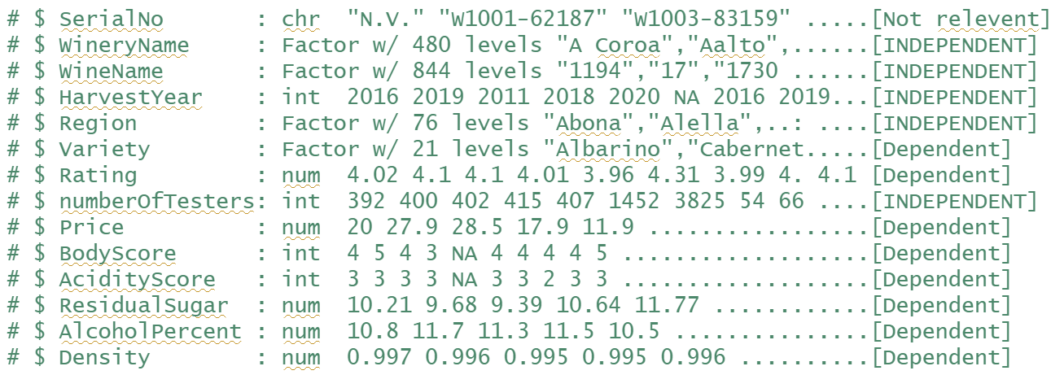
Data Sanity Checks
Variable Analysis (contd)
Dependent or Independent variables: By analysing
variables we have found some variable are
dependent on other variables Independent but
some are independent.

Slide 9
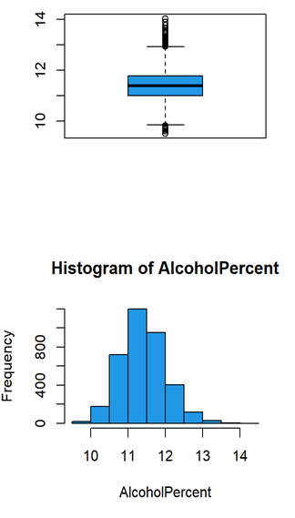
Data Sanity Checks
Variable Analysis (contd)
Checking how many missing values or NA there are in the variables.
Checking the frequencies of values in variable with table().
Checking about the outliers with boxplot.
Representing the frequencies with histogram plot.

Slide 10
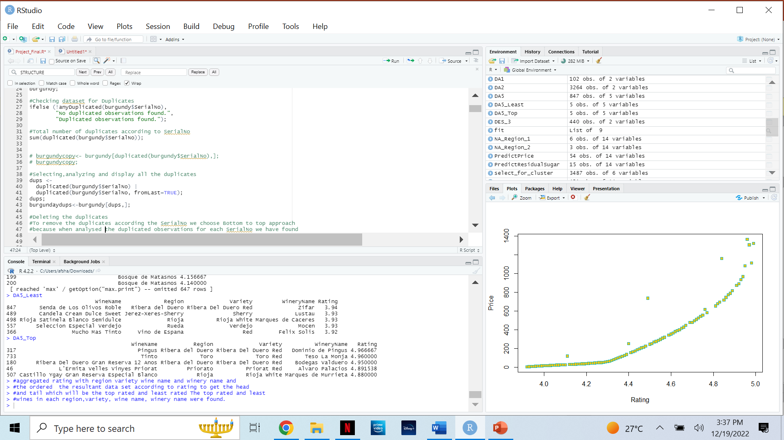
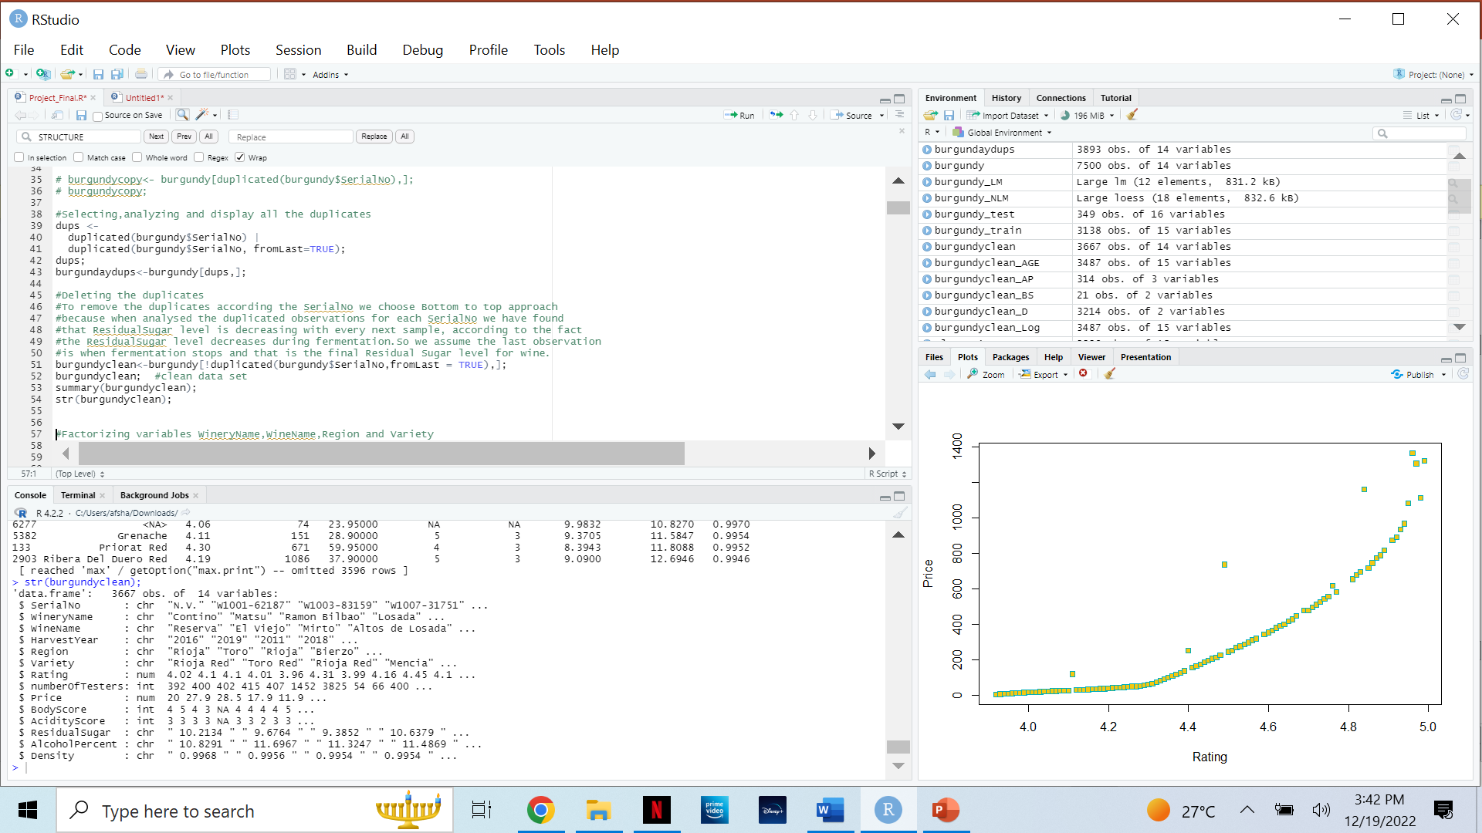
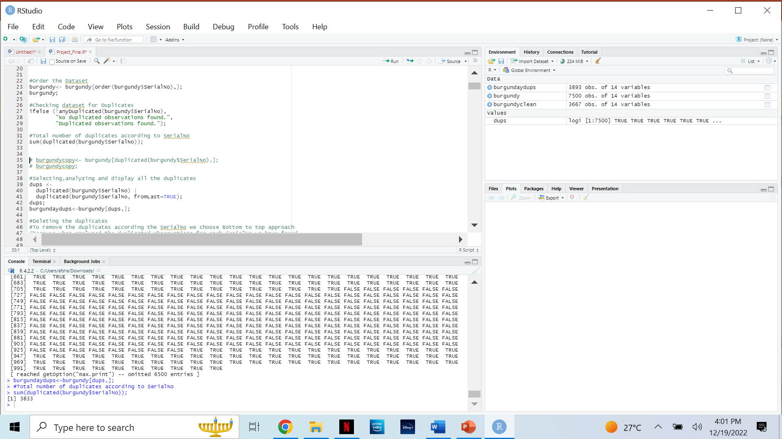
Data Sanity Checks
Checking and calculating duplicates
Treating Duplicate Entries
Process/ Strategy – After order() we check the dataset for duplicates with ifelse() and then display it in the form of TRUE/FALSE. After this we then move on to delete the duplicates with the !duplicated() function.
Findings/ Results – There were 3833 duplicate entries out of 7500 observations. To remove the duplicates according the SerialNo we choose Bottom to top approach because when analyzed the duplicated observations for each SerialNo we have found that ResidualSugar level is decreasing with every next sample, according to the fact the ResidualSugar level decreases during fermentation. So we assume the last observation is when fermentation stops and that is the final Residual Sugar level for wine.
We then deleted the duplicates with the subsetting statement: burgundyclean<-burgundy[!duplicated (burgundy$SerialNo, fromLast = TRUE),];
This brings our total observations to 3667.
Deleting Duplicates
Total Duplicates

Slide 11
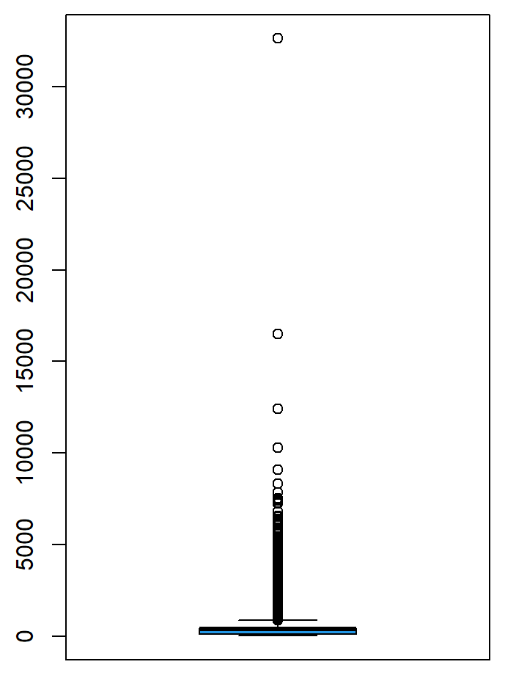
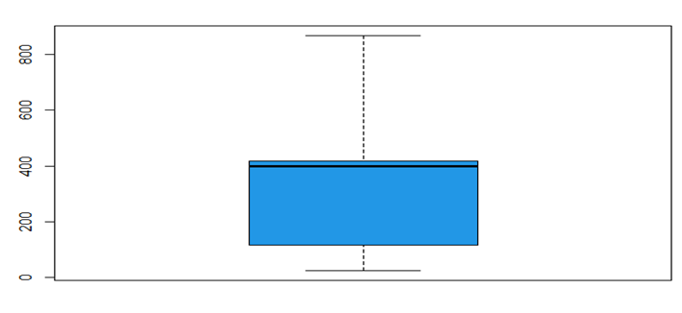
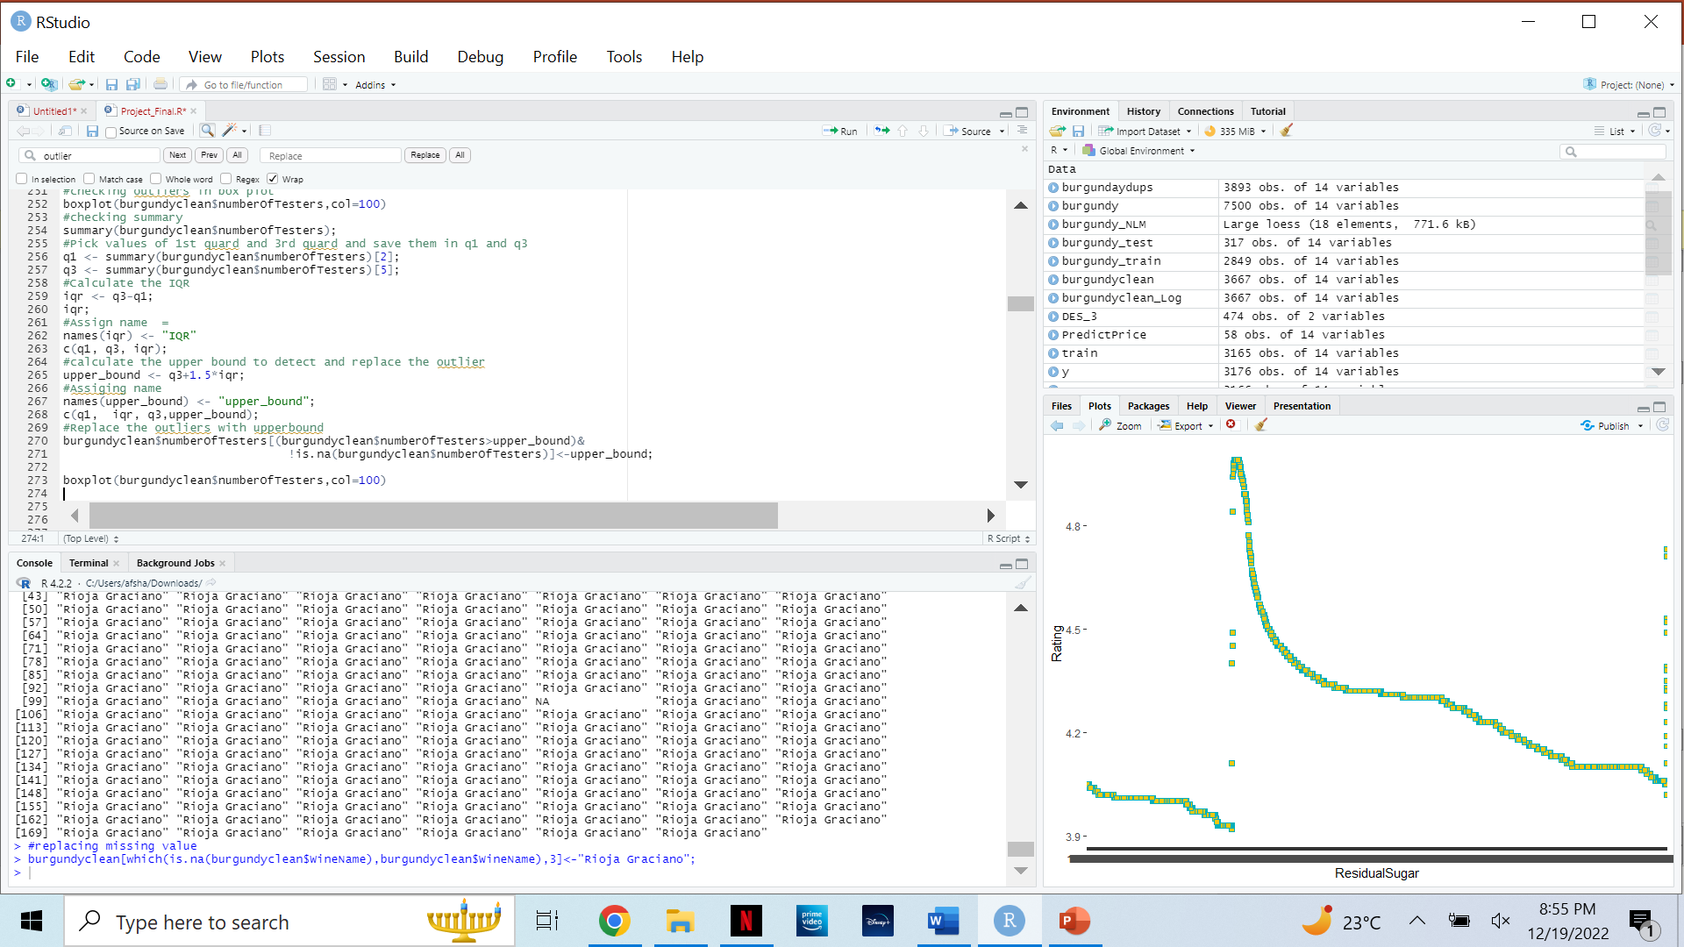
Data Sanity Checks
# Variable NumberOfTesters Before Treating Outliers
Treating Outliers in variable Number of testers
Process/ Strategy – We check the outliers by using boxplot function, calculate Interquartile Ratio & upper bound. The upper bound then detects and replaces the outlier with optimum value.
# Variable NumberOfTesters After Treating Outliers
#Treating Outliers for variable

Slide 12
Data Sanity Checks
OUTLIER FINDINGS
Through our code we have successfully replaced our outliers in variable NumberofTesters . We choose this variable to remove the outliers because we have found that the higher range of values deviates the mean a lot.
In the case of Alcohol Percentage going by our assumption we do not remove the outliers since these outliers are acceptable due to the wider range of Alcohol percentage available in the market.
We didn’t treat the outliers in price variable because we assume the wine could have any price depending on the its demand and quality, There were some outliers in Price variable effecting the regression model we just avoided them for regression prediction.
Outliers in rest of the variables are acceptable when comparing with given range by the stakeholder.

Slide 13
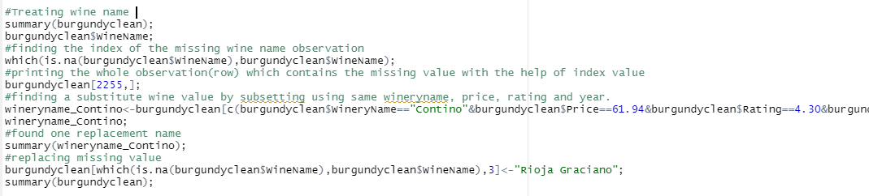
Data Sanity Checks
FINDINGS
Treating Missing Values Entries
Process/ Strategy – We first check the correlation between the variables. Then we create the function calculateMissProb to calculate probability of missingness. We then proceed to treat all variables.
Wine and winery are related to each other. Then for further understanding sub-setted the observations using similar winery name, price, rating ad year found in the missing observation. Then filtered out the observation to a replacement of the wine name.
1. Treating wine name – Through Categorical Imputation
#Treating Wine name code

Slide 14
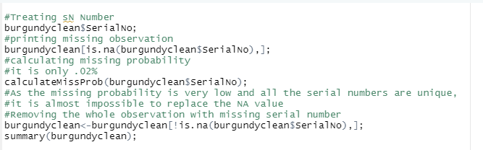
Data Sanity Checks
FINDINGS
2. Serial Number – Due to low missing probability & its unique nature we remove the whole observation.
After removing all the duplicates there was only one observation with missing serial number. As serial number is a unique value it is almost impossible to replace a new SN number. And the probability of missingness is very low. So that observation is removed.
#Treating Serial Number code

Slide 15
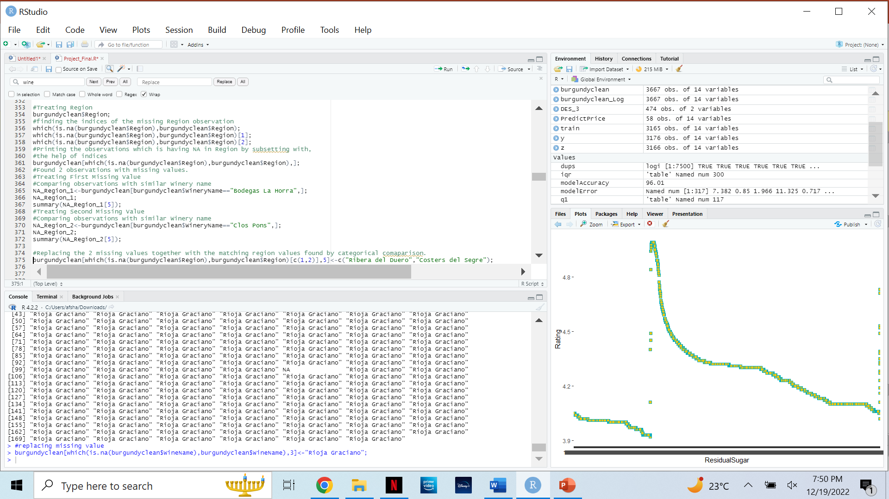
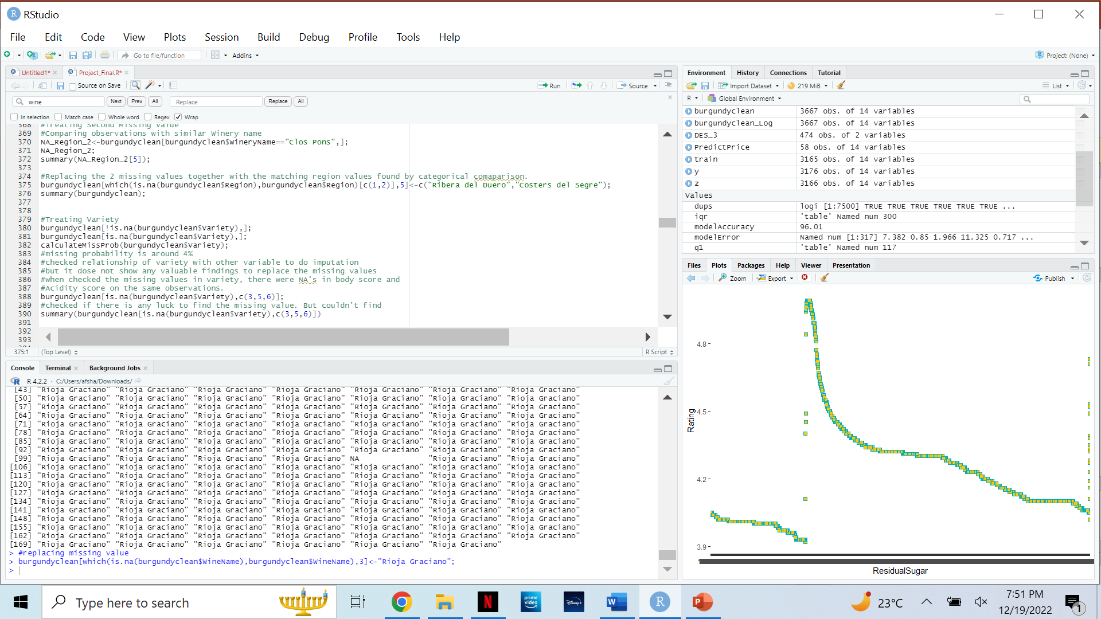
Data Sanity Checks
FINDINGS
3. Region – Treated missing values by categorical Imputation.
There were 2 missing observations with missing region. Region and Winery is related. sub-setted the observations using similar winery names found on the missing observation of region. Replaced the 2 missing values together with the matching region values found by categorical comparison.
#Treating Region code

Slide 16
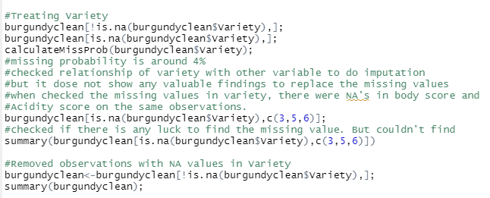
Data Sanity Checks
FINDINGS
4. Variety - checked the missing values in variety, there were NA's in body score and Acidity score on the same observations, therefore we removed the whole observation.
The Missing probability is around 4%. The relationship of variety with other variables is checked to do imputation, but it does not show any valuable findings to replace the missing values. And also while checking the missing values in variety, observed that there were NA's in body score and Acidity score as well on the same observations. So concluded that it is not possible to replace the missing value and decided to delete the entire observations which carry the NA for Variety.
#Treating Variety code

Slide 17
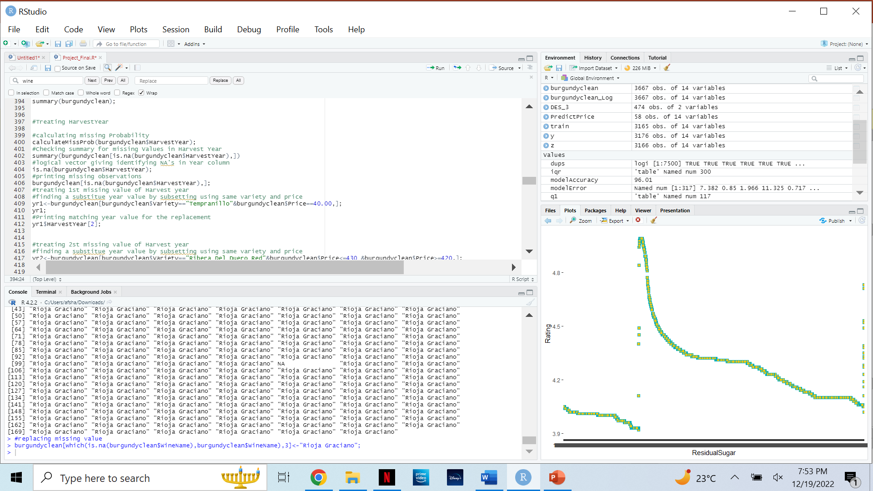
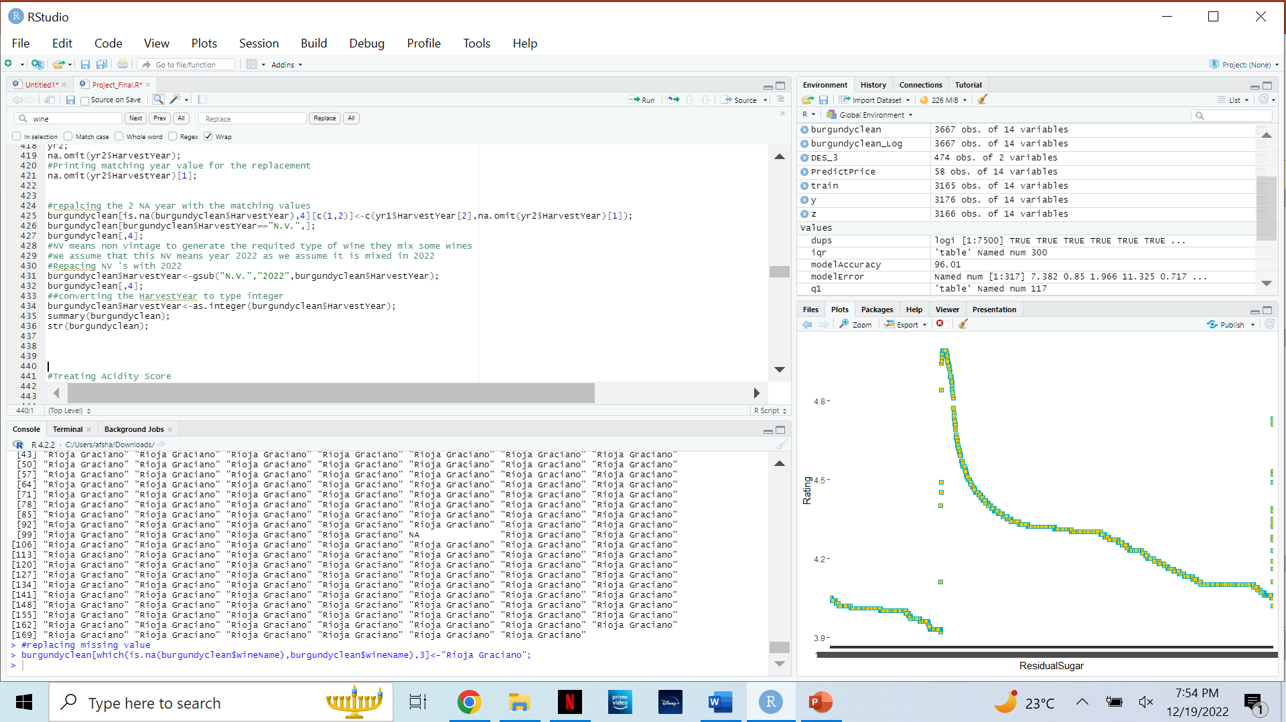
Data Sanity Checks
FINDINGS
5. Harvest Year – Treated by categorical imputation
There where 2 missing values in the Harvest year. Treated missing values one by one. Found the replacement values by sub-setting the observations that carry similar variety and price range as the missing harvest year observation.
All the NV(aka non-vintage) values are then replaced with 2022(Present Year) as per the assumptions made.
#Treating Harvest Year code

Slide 18
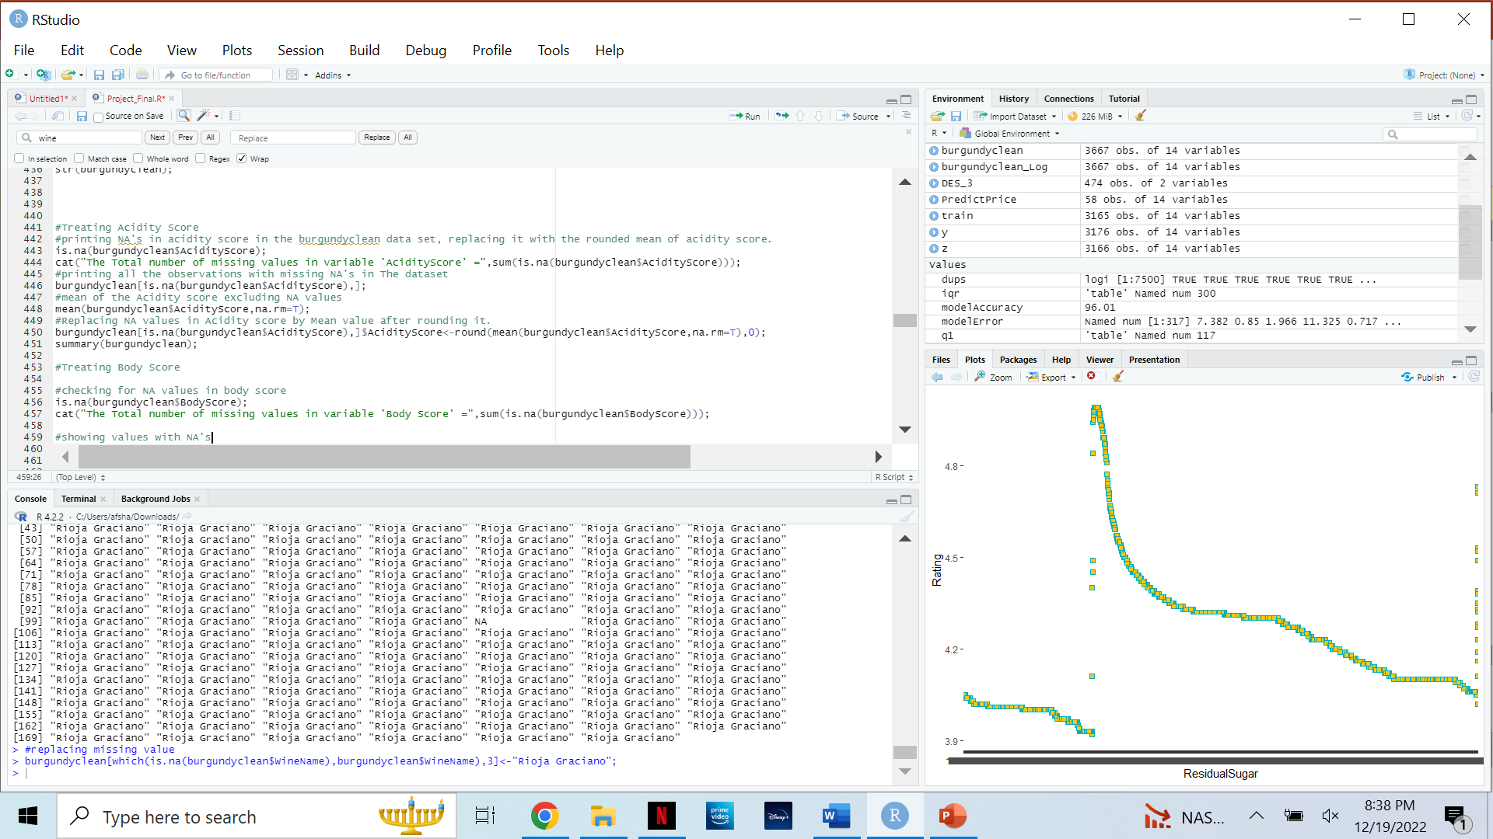
Data Sanity Checks
FINDINGS
6. Acidity Score – Treated using single imputation method
There were 285 missing values left with the Acidity score. Checked summary of Acidity score and the range of values. Values ranged from 1 to 3 and the mean is 2.95. Decided to go with replacing the NA values with the mean.
The most frequent value was 3 and all the acidity score was whole numbers. So, the mean value is rounded to the nearest whole number and replaced
#Treating Acidity Score code

Slide 19
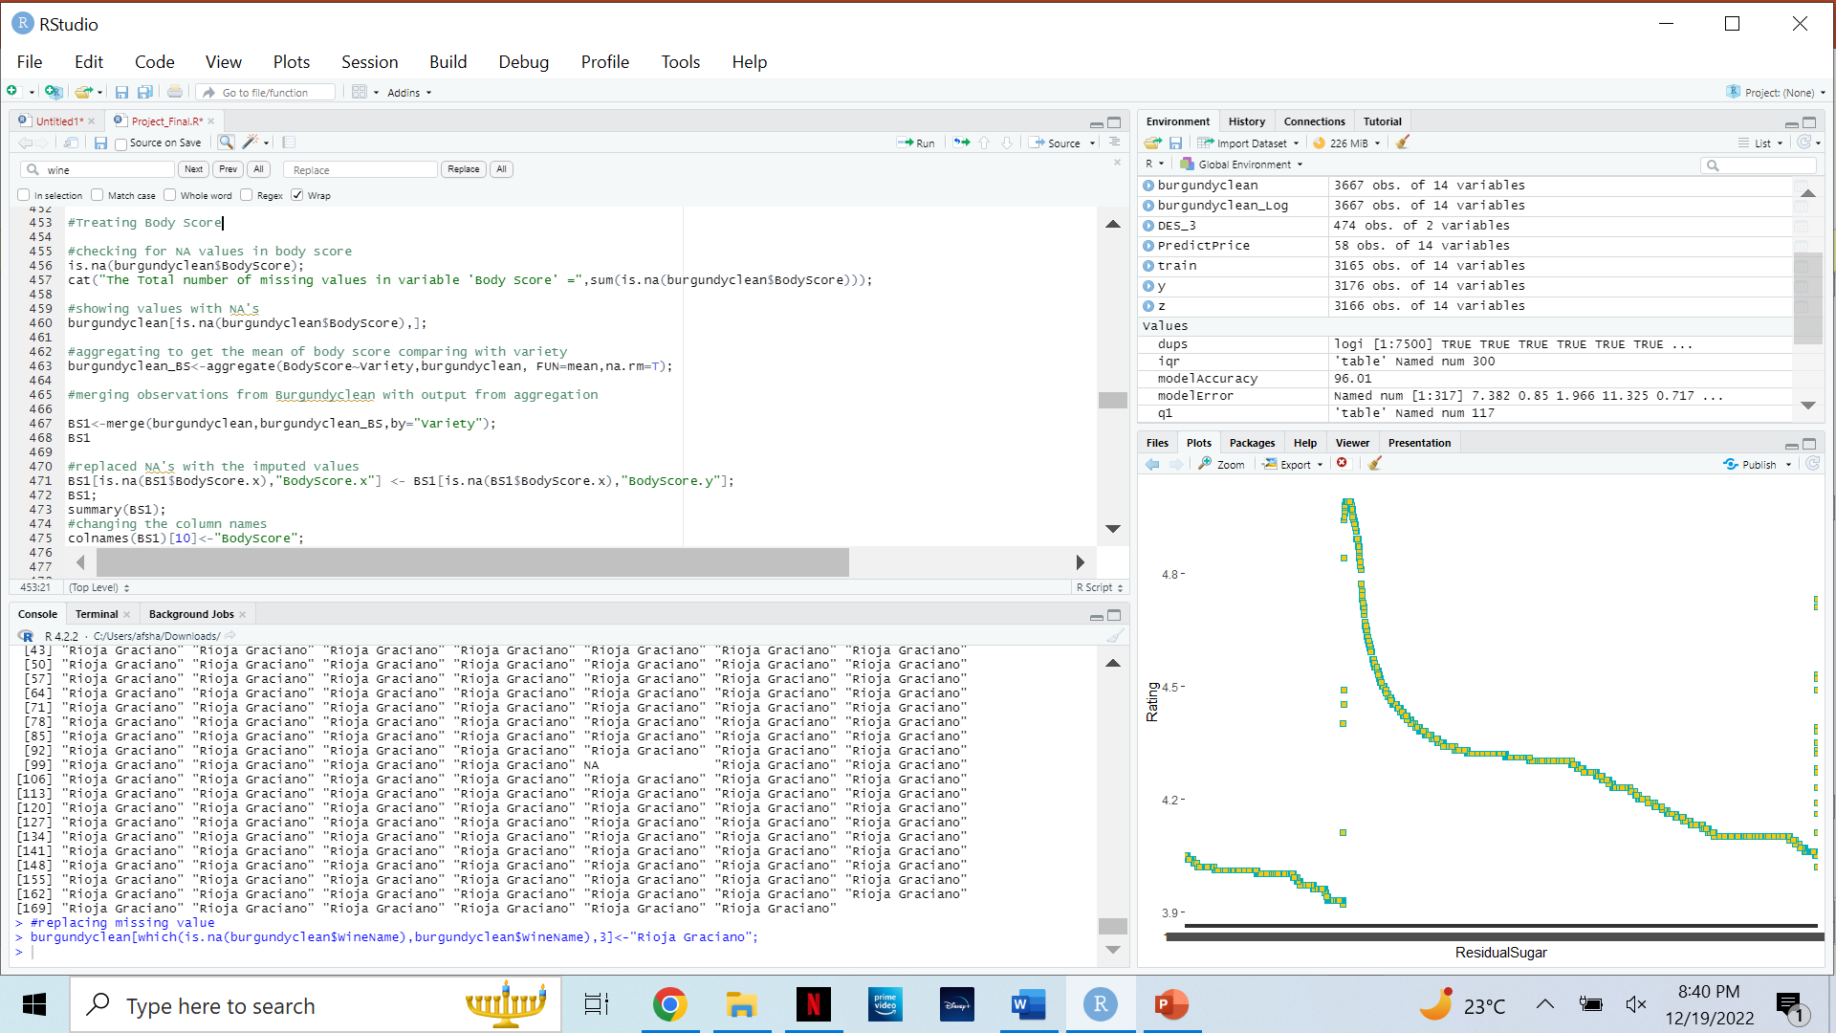
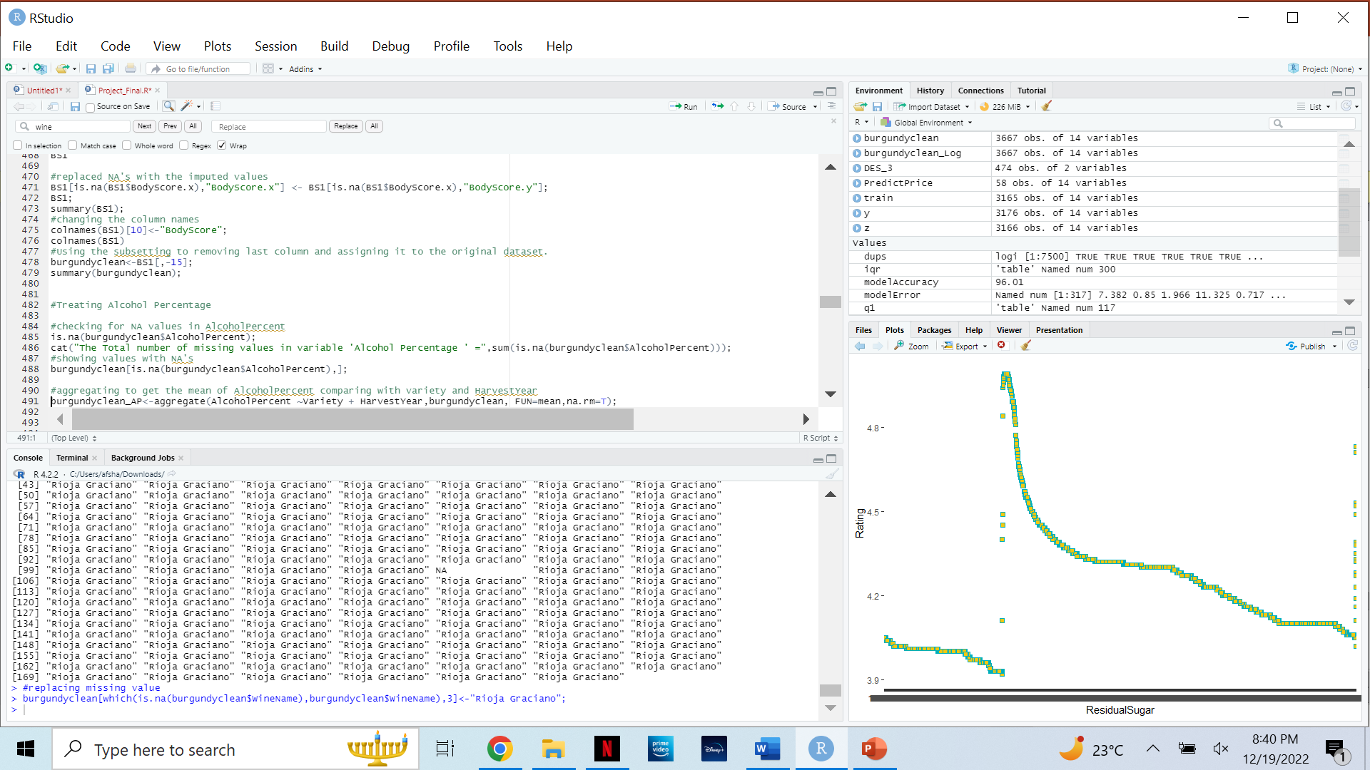
Data Sanity Checks
FINDINGS
7. Body Score– Treated using categorical imputation.
There were 285 missing values left with the Body score. Body score and variety are related. Used aggregate function and created a dataset to find the mean of body score by excluding NA values. Merged the aggregated dataset with the original dataset by variety and Harvest year. Then replaced the NA values with the new aggregated value with the help of sub-setting the NA observations.
#Treating Body Score code

Slide 20

Data Sanity Checks
FINDINGS
8. Alcohol Percentage – Treated using categorical imputation.
There were 35 missing values left with the Alcohol Percentage. Body score and variety are related. Used aggregate function and created a dataset to find the mean of Alcohol Percentage by excluding NA values. Merged the aggregated dataset with the original dataset by variety. Then replaced the NA values with the new aggregated value with the help of subsetting the NA observations.
#Treating Alcohol Percentage code

Slide 21
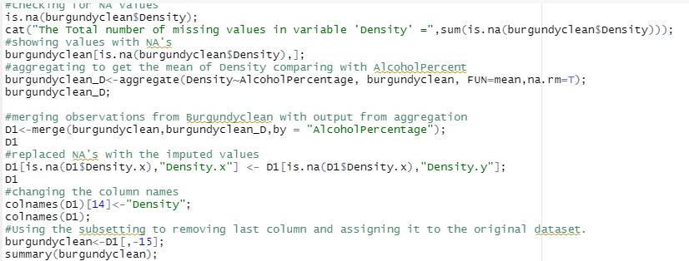
Data Sanity Checks
FINDINGS
9. Density – Treated using categorical imputation.
There were 29 missing values left with the Density. Body score and variety are related. Used aggregate function and created a dataset to find the mean of Density by excluding NA values. Merged the aggregated dataset with the original dataset by Alcohol Percentage. Then replaced the NA values with the new aggregated value with the help of sub-setting the NA observations.
#Treating Density code

Slide 22
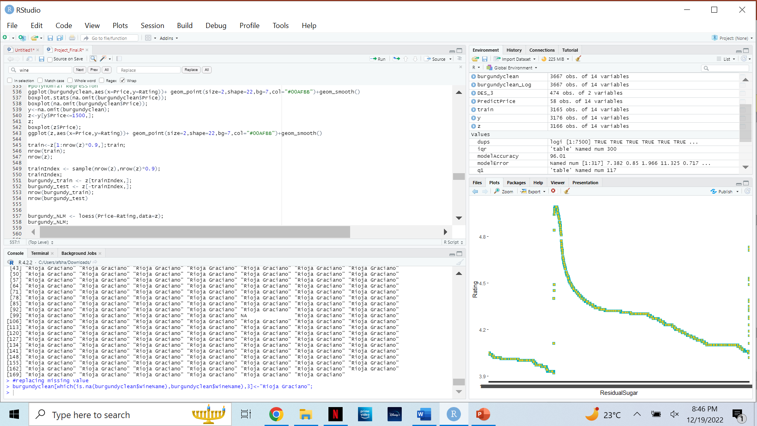
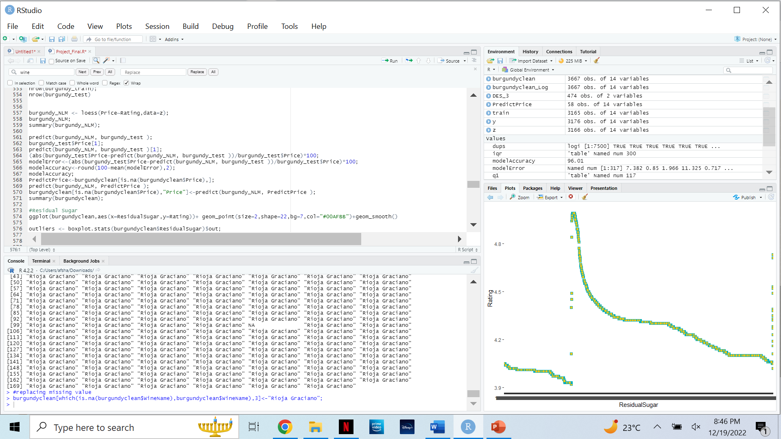
Data Sanity Checks
FINDINGS
10. Price
There were 58 missing values left with the Price. Rating and price are related. Used regression model to find the most accurate values of price by excluding NA values. The regression model was created by first making the train set to train the model and the test set to verify the accuracy of the model. Then replaced the NA values with the predicted vector for NA price values based on their rate.
#Treating Price code

Slide 23
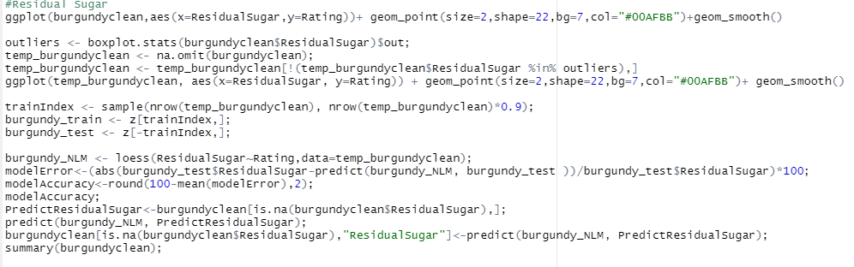
Data Sanity Checks
FINDINGS
11. Residual Sugar
There were 18 missing values left with the Residual sugar. Rating and the residual sugar are related. Used regression model to find the most accurate values of residual sugar by excluding NA values. The regression model was created by first making the train set to train the model and the test set to verify the accuracy of the model. Then replaced the NA values with the predicted vector for NA residual sugar values based on their rate.
#Treating Residual Sugar code

Slide 24
Predictive Analysis and Findings
Objectives Achieved
Model
Historical data was analyzed and prediction models were built for future outcomes of an actions takes in a business processes.
Wine shop can set the price for a bottle of the wine based on its rating.
Wine shop able to predict the residual sugar level based on rating.
Wine shop can predict alcohol percentage of wine based on its density.
Two polynomials models to predict the price and the residual sugar
One logarithmic regression model.

Slide 25
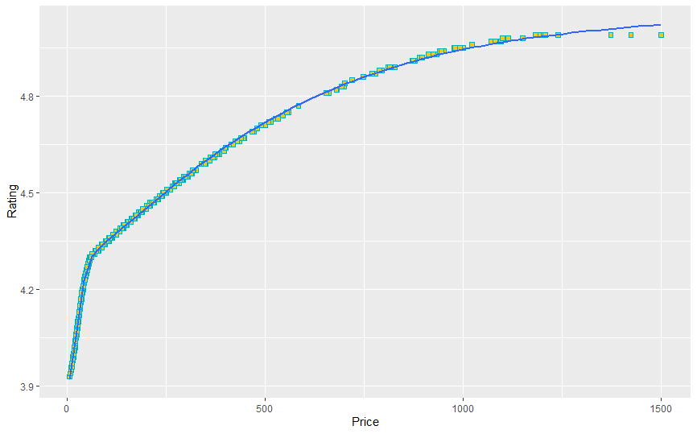
Predictive Analysis and Findings
Polynomial regression model for Price & Rating
Visual Artifacts
The price of wine and rating have kind of linear relationship. We can create polynomial regression for that to make it more accuracy.
Outliers were deleted to calculate correct coefficients for the polynomial regression model.

Slide 26
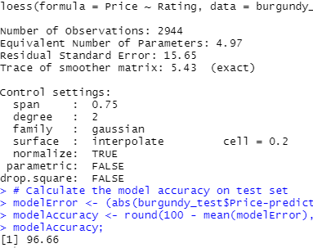
Predictive Analysis and Findings
Findings
The model for predicting price based on input rating shows us accuracy within 96.66%. It’s a good positive prediction accuracy. With this model were treated 58 missing values in the price column.
Model summary

Slide 27
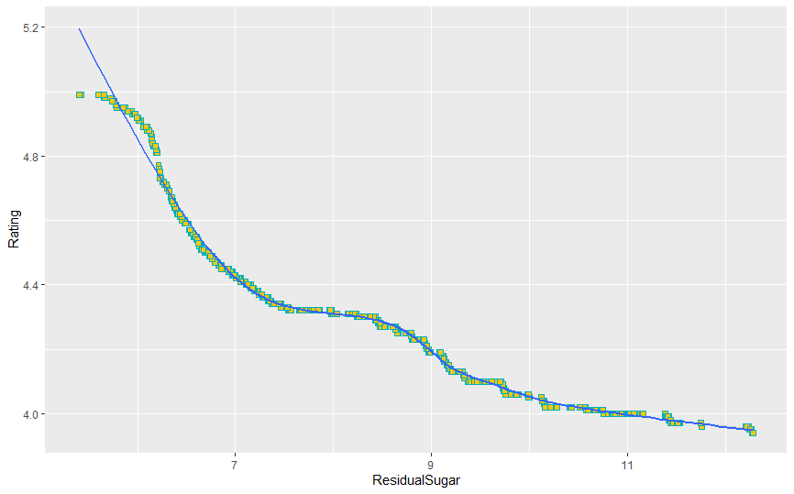
Predictive Analysis and Findings
Polynomial regression model for Sugar & Rating
Visual Artifacts
The residual sugar of wine and rating have kind of some relationship.For sure we need the polynomial regression for that to make predictions more accurate.
Outliers were deleted to calculate correct coefficients for the polynomial regression model.

Slide 28
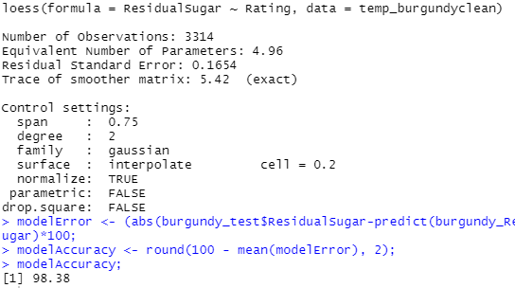
Predictive Analysis and Findings
Findings
The model for predicting residual sugar based on input rating shows us accuracy within 98.38%. It’s a great positive prediction accuracy. With this model were treated 18 missing values in the residual sugar column.
Model summary

Slide 29
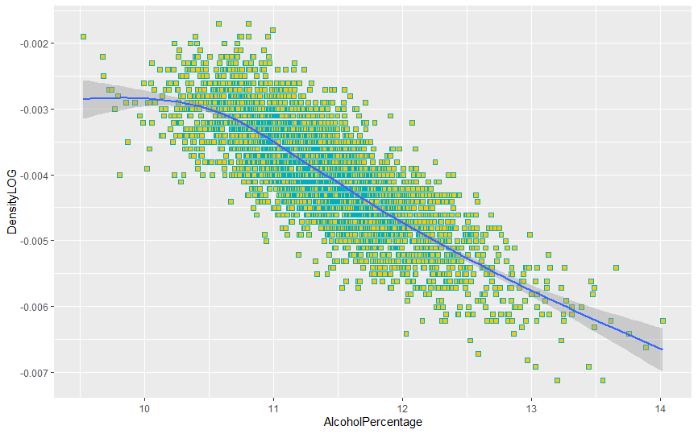
Predictive Analysis and Findings
Logarithmic regression model for Alcohol Percentage & Density
Visual Artifacts
The alcohol percentage of wine and density have logarithmic relationship. Logarithmic regression used for that to make predictions more accurate.
The density was logged.

Slide 30
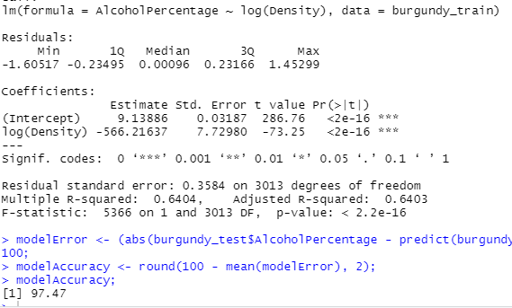
Predictive Analysis and Findings
Findings
The model for alcohol percentage based on input density shows us accuracy within 97.47%. It’s a good positive prediction accuracy.
Model summary

Slide 31
Cluster - Based Analysis and Findings
Objectives Achieved
Model
There were found three cluster groups: (“Sweet”, “Semi-sweet”, “Dry”) of wines. Three cluster solution is optimal for k-means.
Based on output information there was made conclusion about best profit strategy. The most high profit wines would be dry wines due to high rating, big volume of testers and high price.
k-means model

Slide 32
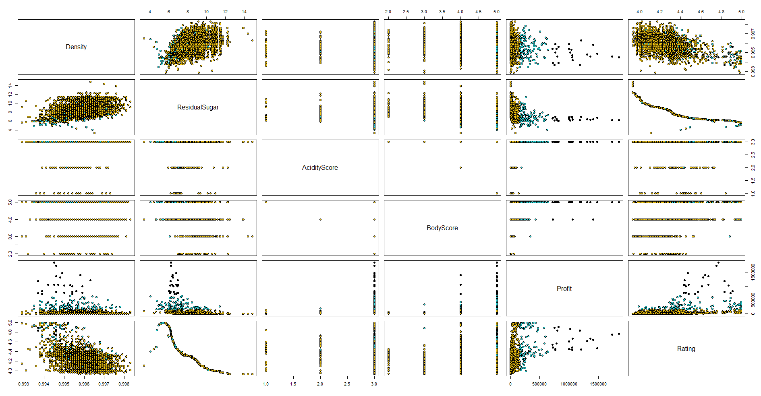
Cluster - Based Analysis and Findings
Visual Artifacts

Slide 33
Cluster - Based Analysis and Findings
Findings
Assortment of wine shop can be divided in three groups: “Sweet”, “Semi-sweet”, “Dry” based on k-means..

Slide 34
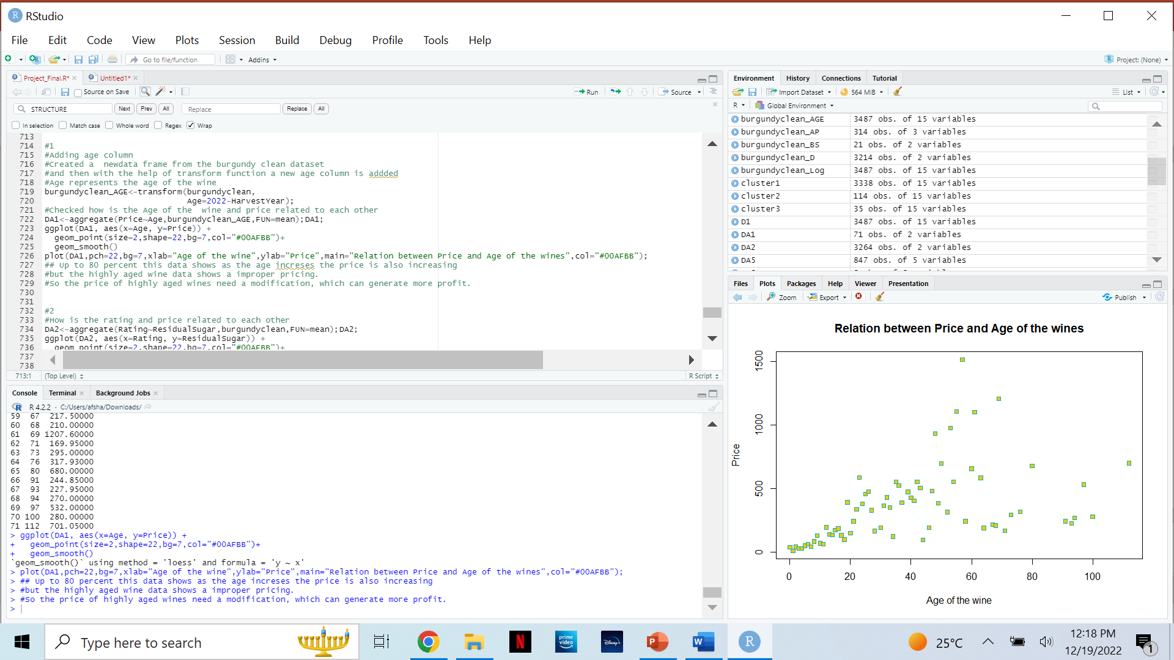
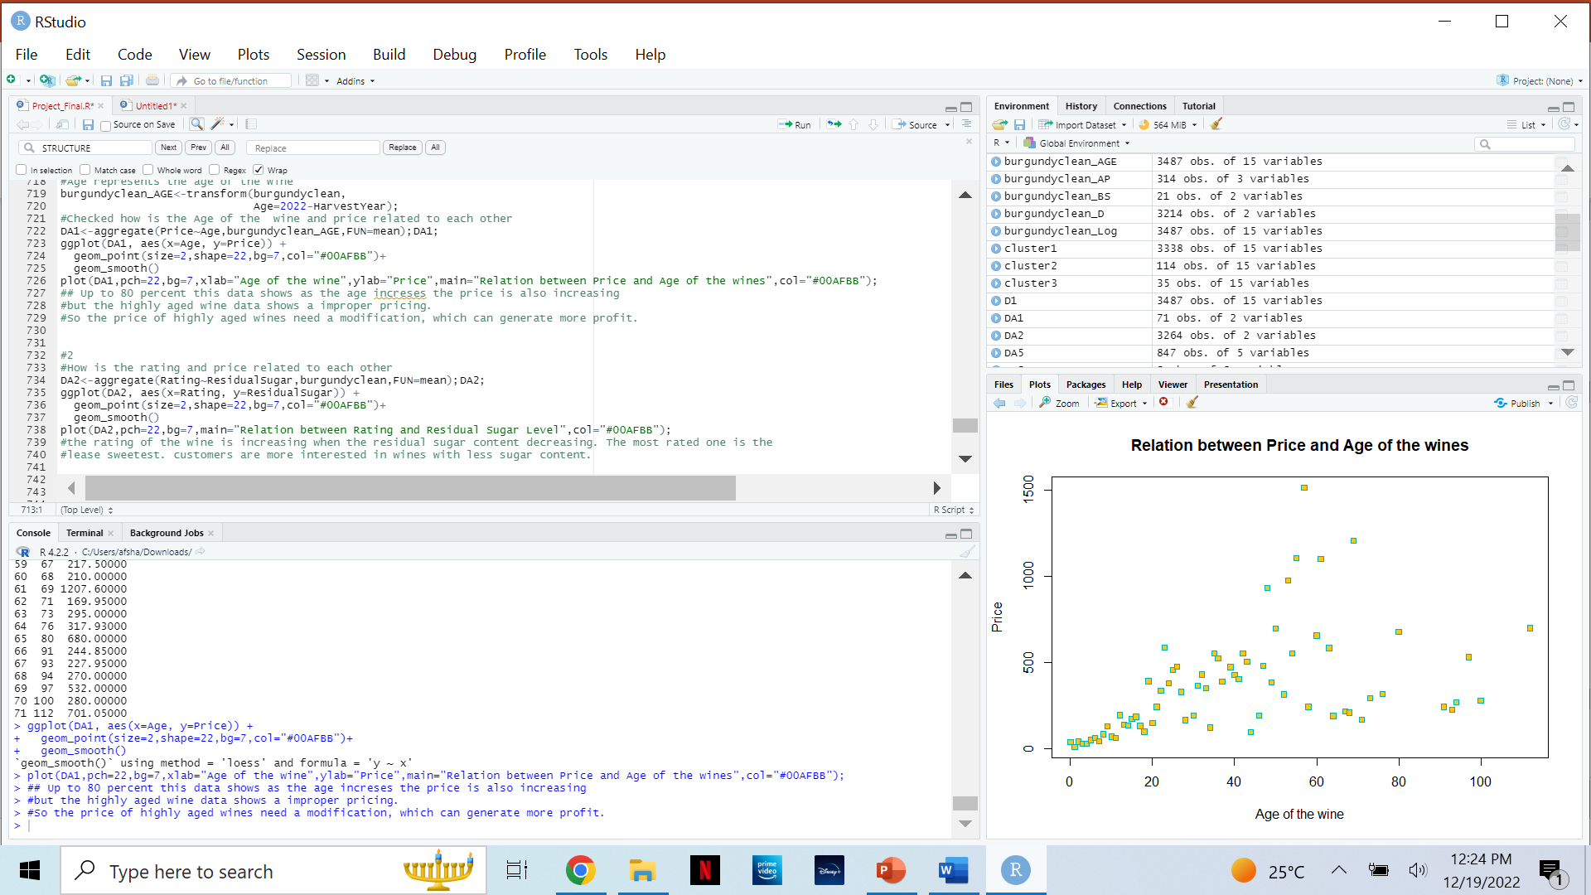
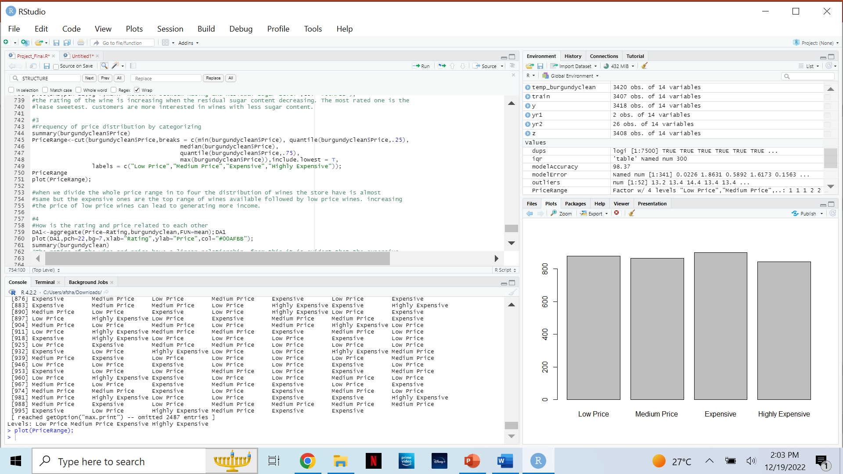
Descriptive Analysis and Findings
Calculations Performed
PART 1
Relationship between Age of Wine and Price of Wine : Add the wine age column through transform(), Find the relationship by acquiring the mean summary statistics through aggregate()
Relationship between Rating of Wine and Residual Sugar of Wine : Find the relationship by acquiring the mean summary statistics through aggregate()
Frequency of price distribution by categorizing : Here we use cut(), which divides our numeric value price into low, medium, high expensive & expensive. The cut is done through calculating the min, max, median & quantile .25,.75.
PART 2
PART 3

Slide 35
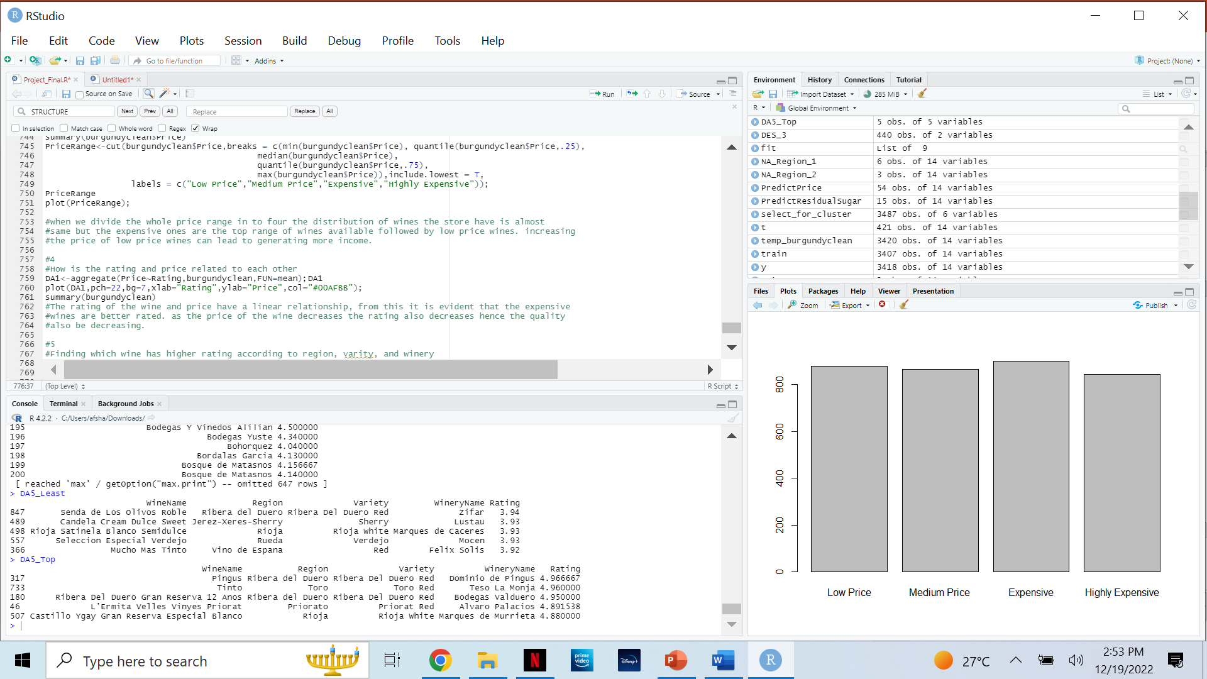
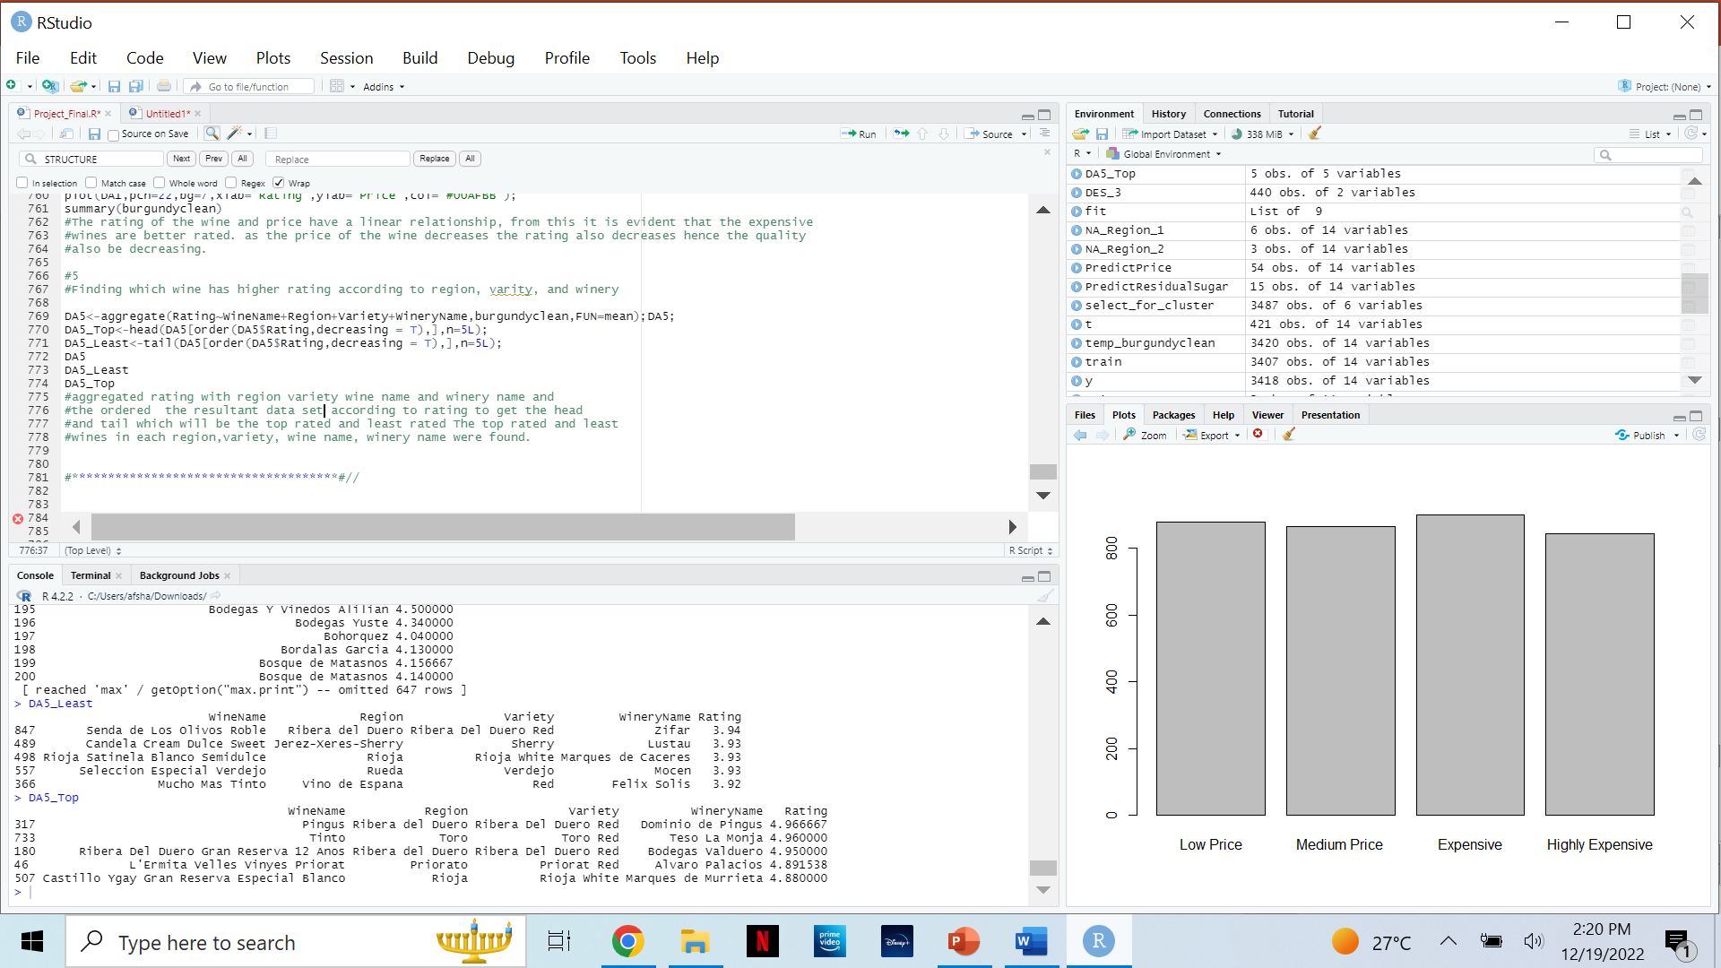
Descriptive Analysis and Findings
Calculations Performed
PART 4
4. Relationship between Price of Wine and Rating of Wine : Find the relationship by acquiring the mean summary statistics through aggregate().
5. Wine that has the highest rating according to wine region, wine variety and winery : Find the aggregated rating according to region, variety & winery through aggregate(). Print the results by assigning order() function in decreasing format to variable. (D5_head prints the head in order, while Tail prints the lowest in order- assigned variable - D5_Top,D5_Least)
PART 5

Slide 36
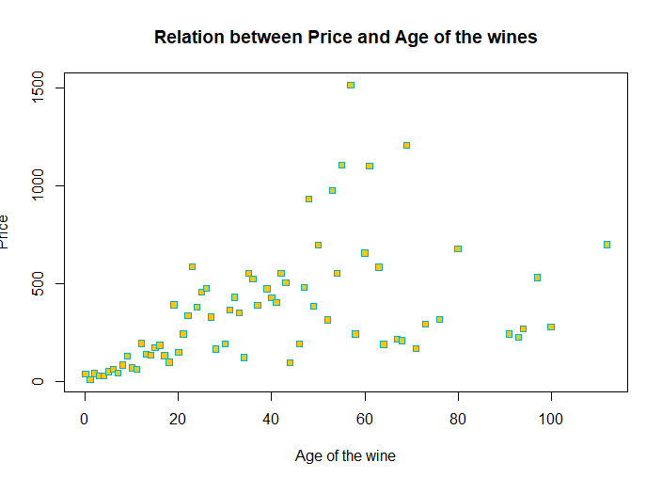
Descriptive Analysis and Findings
Visual Artifacts & Findings
Up to 80 percent of this data shows that as age increases the price also increases
Highly aged wine data shows improper pricing.
Our conclusion from this is that the price of highly aged wines need a modification, which can generate more profit
#Use of scatterplot to accurately plot points

Slide 37
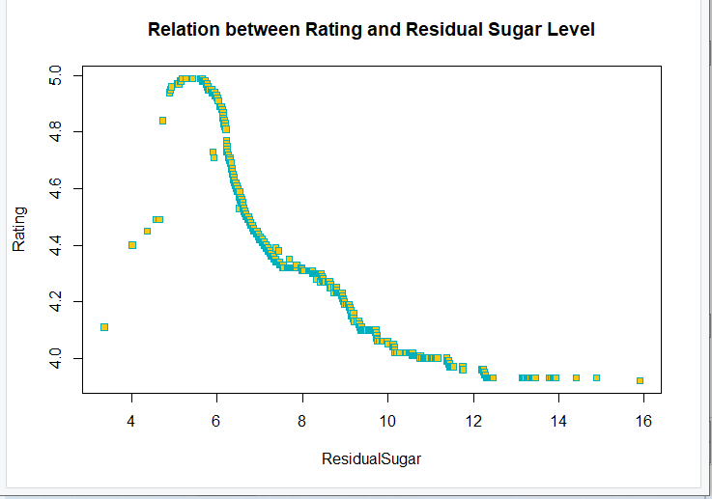
Descriptive Analysis and Findings
Visual Artifacts & Findings
The rating of wine shows an increase with a decrease in the residual sugar content.
Therefore, we see the highest rated ones are have less residual sugar compared to lower rated ones which are high in residual sugar.
From this we can conclude that customers are more interested in wines with less sugar content.
#Use of scatterplot to accurately plot points

Slide 38
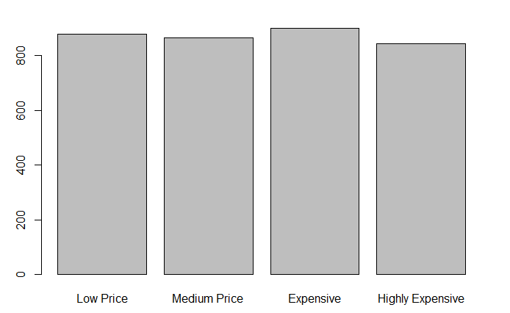
Descriptive Analysis and Findings
Visual Artifacts & Findings
Frequency of price distribution by categorizing
After dividing the range of price into 4 distributions of wine we find that the store has almost the same number of low price, medium price, expensive & highly expensive wine.
Expensive ones are the highest followed by low price, medium price and highly expensive
The rating of low priced wines are low and there is a large stock of these are available at store so that the stock quantity needs to be reduced to save cost
#Use of Histogram to accurately depict frequency of price distribution

Slide 39
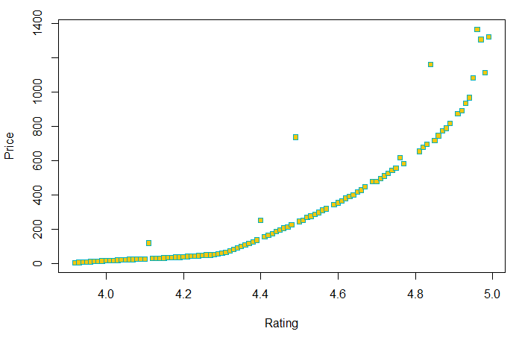
Descriptive Analysis and Findings
Visual Artifacts & Findings
Relationship between Rating & Price
The price of wine and rating have a linear relationship.
The higher the wine is rated the more it costs leading us to conclude that the higher the price the higher the quality of the wine and vice versa.
#Use of scatterplot to accurately plot points

Slide 40
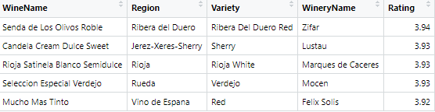
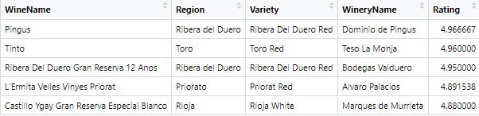
Descriptive Analysis and Findings
Least Rated wines
Visual Artifacts & Findings
We’ve got the top 5 rated wines, and the lowest 5 rated wines according to region, variety & winery.
Top Rated wines

Slide 41
Conclusion & Recommendation
Based on our Analysis, our conclusion for burgundy wine shop is to change their assortment strategy to make more profit. The wine shop has too many bottles of sweet wine in the shop, and less bottles of semi-sweet and dry wines. As a result, it’s does lead to best profit strategy.
For this we recommend the following solutions:
Allocate most of the inventory to Dry wines, second to Semi – Sweet and Third to Sweet wines.
The rating of wines with less sugar content is higher compared to wines with high sugar content. The store have to be more focused on wines with lesser sugar content
The pricing of highly aged wines needs to be recalculated to generate more revenue. As of now the highly aged wines are lesser compared to the middle-aged wines
The expensive wines are rated high compared to low-priced ones.

Slide 42
Thank you!

